Slide 1
Secure authentication method using Honey key Password in Online Shopping
Team Details
Project Supervisor
Name : Mrs. P. Swarajya Lakshmi Designation : Assistant Professor
A.Manidhar(20EG105303)
B. Sucharitha(20EG105316)
L. Sravanthi(20EG105708)

Slide 2
Introduction
One of the most widely used safe mechanisms for online applications in the real world is password-only authentication. However, it is easily vulnerable to a real threat - password leaks caused by both internal and external attackers. Insiders may purposefully steal credentials or unintentionally leak them, while external attackers may compromise the password file kept on the authentication server. As of right now, there are two primary methods for dealing with the leak: the use of honeyword technique for external attackers and augmented password-authentication key exchange (aPAKE) for insiders. But none of them are able to withstand both blows. In order to bridge the gap, we introduce the concept of honey PAKE (HPAKE), which enables the authentication server to identify password leaks and provide security that goes beyond the limitations of aPAKE.

Slide 3
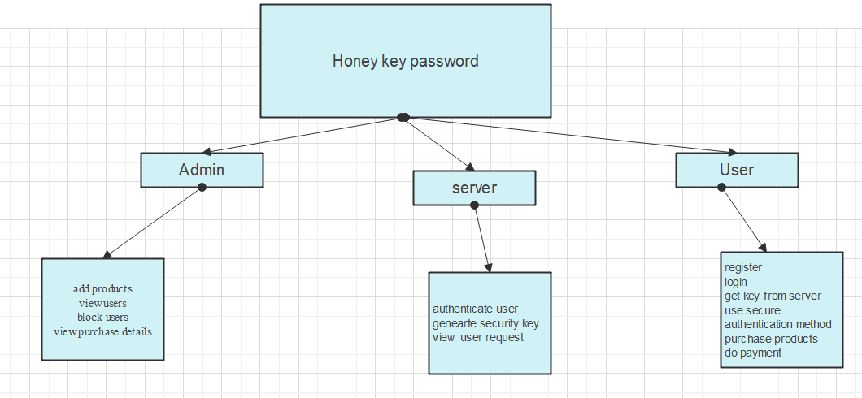
Concept Tree

Slide 4
Literature
SNO | STRATEGIES | ADVANTAGES | DIS-ADVANTAGES
1 | Securing password authentication for web-bases applications. | Improved security against phishing and MITM attacks. End-to-end security | Backward compatibility issue. Potential user confusion
2 | Protecting account from credential stuffing with password breach alerting | Privacy preserving Centralized breach repository Allows credential migration | Dependency on central repository Limited scope Implementation complexity
3 | Strong Asymmetric PAKE protocol (OPAQUE) | Keeps your passwords safe even if attackers gain access to the server Protects against quick password guessing through pre-computation attacks | Requires a bit more back-and-forth communication Vulnerable to dictionary attacks if the server is compromised
4 | Honeywords: Making Password-Cracking Detectable | Increased complexity for attackers Immediate response to compromise | Chance of false alarms Potential for honey word database compromise.

Slide 5
Problem Statement
The prevalent use of password-only authentication in online shopping platforms has led to vulnerabilities from both external attacks and insider threats. Current methods, susceptible to password leaks and the risks associated with augmented password-authenticated key exchange (aPAKE), call for an innovative solution. This project introduces Honey Password Authenticated Key Exchange (HPAKE) to address these concerns. HPAKE implements a stringent registration process, mandating users to upload a text file and provide a secret key pair. This approach not only strengthens authentication but also proactively identifies potential password leaks. Given the limitations of existing methods in the realm of online shopping security, there is an urgent need for comprehensive solution like HPAKE. Its integration represents a substantial advancement, offering improved defense against both external adversaries and insider threats, thereby elevating the overall security of user credentials in the dynamic digital landscape.

Slide 6
Problem Illustration
Compromising the session keys is the attacker’s goal. To test if the attacker knows the session key or the partial information about the session key, we require the attacker to distinguish the session key from a random number.
Sender (S): Possesses a unique key (e.g., a secret number).
Challenger (C): Observes and ensures security.
Attacker: Tries to gain access to the secure lockbox or impersonate others.
Numeric Values:
Secure Lockbox key(session key):
A secret number, let say 42 Previous Legitimate message:Message_1=“Hello world”

Slide 7
Send(S, i, C, M):
Sender (S) wants to send a message. Previous legitimate message: Message_1 = "Hello World".
Attacker (imposter) tries to send a message (M) to the challenger (C).
If M is not "Hello World", the Send query is considered rogue.
Send(C, i, S, M):
Attacker (imposter) pretends to be the challenger and interacts with the sender (S).
If the message (M) sent by the attacker was responded to by S before, the interaction is executed, and the response is given to the attacker.
2. Reveal Query:
Reveal(S, i):
Attacker asks the challenger to reveal information about the secure lockbox key of the sender (S).
If the revealed key is 42, it's considered real.
3. Corrupt Query:
Corrupt(C):
Attacker asks the challenger to reveal internal states and details about its own security mechanisms.
This information allows the attacker to impersonate the challenger.

Slide 8
Proposed Method
In proposed method password authenticated key exchange mechanism is used to secure user authentication process using (HPAKE) model that provides the theoretical basis for this construction and is backed by crypto graphic proofs of security When user registers with application a security key with unique input values are taken in the form of text file and security key for data is generated by server which is sent to user mail id for login. User need to login to application with same security key and same file with same data in the file. This method is shown in online purchase platform where fraud transactions from users with wrong payment details are blocked by admin.
1/29/2024
Department of Computer Science and Engineering
9

Slide 9
Proposed Method Illustration
HPAKE Extra enhances security through an AES-encrypted server-authenticated channel, safeguarding communication. It employs honeywords generated via a probability model, adding complexity to thwart potential attacks. The honeychecker validates the authenticity of honeywords, bolstering the authentication process. A secure channel between the authentication server and honeychecker ensures confidential information exchange. Notably, the protocol strictly prohibits server access to password plaintext, mitigating risks associated with real-password-based methods. HPAKE Extra prioritizes alternative, secure approaches, contributing to a robust authentication system. This comprehensive framework strengthens user credential protection and system integrity. In essence, HPAKE Extra combines encryption, honeywords, and secure channels to fortify authentication in an innovative and secure manner.

Slide 10
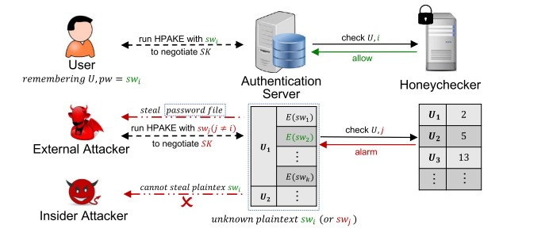

Slide 11
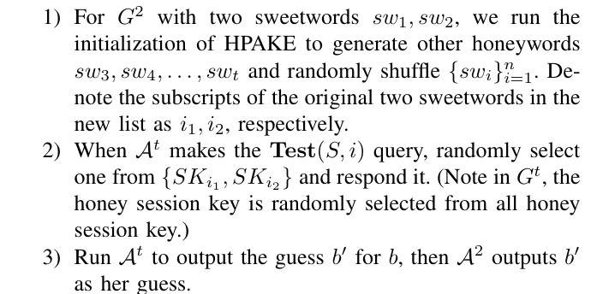
Parameter

Slide 12
Experiment Environment
Software Requirements:
Operating System - Windows XP
Coding Language - Java/J2EE(JSP,Servlet)
Front End - J2EE
Back End - MySQL

Slide 13
Project status
S.No | Functionality | Status (Completed /in-progress/Not started)
1 | Literature survey | Completed
2 | Design Phase | Completed
3 | Coding Started web page design | Not Started
4 | Logic implementation | Not Started

Slide 14
References
[1]. T. G. Tan, P. Szalachowski and J. Zhou, "Securing Password Authentication for Web-based Applications," 2022 IEEE Conference on Dependable and Secure Computing (DSC), Edinburgh, United Kingdom, 2022.
[2]. Kurt Thomas, Jennifer Pullman, Kevin Yeo, Ananth Raghunathan, Patrick Gage Kelley, Luca Invernizzi, Borbala Benko, Tadek Pietraszek, Sarvar Patel, Dan Boneh_x0005_ Elie Bursztein”Protecting accounts from credential stuffing with password breach alerting.”
[3].A. Juels and R. L. Rivest, “Honeywords: Making password-cracking detectable,” in Proc. ACM CCS, 2013, pp. 145–160.
[4].S. Jarecki, H. Krawczyk, and J. Xu, “OPAQUE: An asymmetric PAKE protocol secure against pre-computation attacks,” in Proc. EUROCRYPT. Cham, Switzerland: Springer, 2018, pp. 456–486.
[5]. S. M. Bellovin and M. Merritt, “Augmented encrypted key exchange: A password-based protocol secure against dictionary attacks and password file compromise,” in Proc. ACM CCS, 1993, pp. 244–250

Slide 15
Thank you

Slide 16
Project seminar–I Evaluation
S.No | Rubrics | Marks
1 | Concept Introduction | 4
2 | Literature and Parameter | 5
3 | Problem and Problem Illustration | 8
4 | Proposed Method and Illustration | 8
Total |  | 25

